Slide 1
SOLUTIONS lect-2

Slide 2
Type of solutions
There r three types of interactions in the solution process:
1. solvent-solvent interaction.
2. solute-solute interaction.
3. solvent-solute interaction.

Slide 3

Molecular view of the formation of solution
ΔHsol. = ΔH1 + ΔH2 + ΔH3
ΔH1 = break up of solvent(exothermic)
ΔH2 = break up of solute( exothermic)
ΔH3 = mixing them, (can be exothermic or endothermic).
- if the solute-solvent attraction ˃ (solute-solute and solvent-solvent) attraction, the solution process is favorable and ΔHsol. ˂ 0.
- if the solute-solvent attraction ˂ (solute-solute and solvent-solvent) attraction , the solution process is endothermic and ΔH sol.˃ 0. solute
Solvent

Slide 4

Factors governing solution process :
1- energy (exothermic or endothermic)
2- tendency towards disorder :
[ wn solvent or solute is pure ,it has fair degree of order]

Slide 5
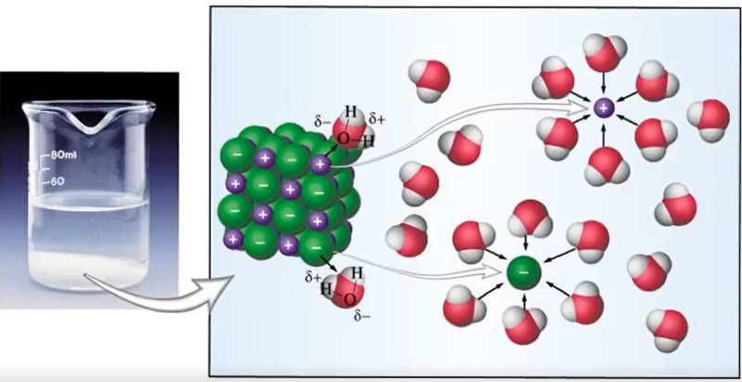
But in a solution : there is an increase of disorder .
Therefore, even if ΔH is (+) ,increase of disorder favors the solubility of a substance.

Slide 6
Solubility : a measure of how much of a solute will dissolve in a solvent at a specific temperature.
Miscible : 2 substances r completely soluble in each other in all properties.
Me-OH, Eth-OH , ethylene glycol r miscible with H2O b of H-B.

Slide 7
Ionic cpd.
- Soluble in H2O ,liq. NH3, liq. HF .
, b non polar has Not soluble in C6H6 and CCl4- no dipole moment, and can not solvate cations and anions.

Slide 8
Solvations: process in which an ion or a molecule is surrounded by solvents molecules arranged in a specific manner.
- wn water is the solvent : solvation is called Hydration.

Slide 9
( (like dissolves like
- 2 substances w similar intermolecular forces are likely to be soluble in each other.
- non polar molecules r soluble in non-polar
CCl4 in C6H6
- polar molecules r soluble in polar solvents
C2H5OH in H2O.
- Ionic cpds r more soluble in polar solvent
NaCl in H2O or NH3.

Slide 10
Predict the relative solubilities in the following cases:
1- Br2 in benzene (C6H6, μ=0 D) & in H2O (μ=
1.87D)
2- KCl in CCl4 (CCl4, μ=0D) & in liq. Amonia (NH3, μ=
1.46 D)
CS2,μ=0 D) & in H2O. 3- Formaldehyde CH2O in CS2 (

Slide 11
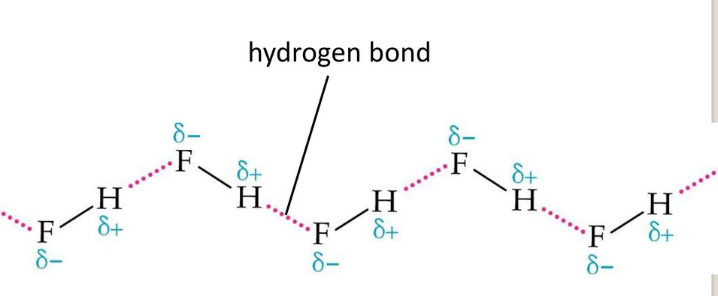
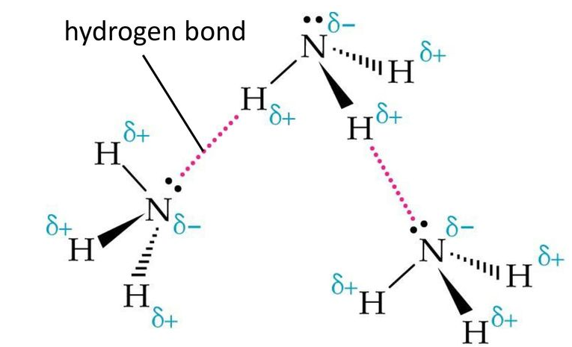
Hydrogen Bond
* Essential requirments for formation of Hydrogen bond :
- H atom must directly bonded to a highly electronegative atom (N, O, F).
- An unbonded pair of electrons (lone pair) is presented on the electronegative atom.

Slide 12
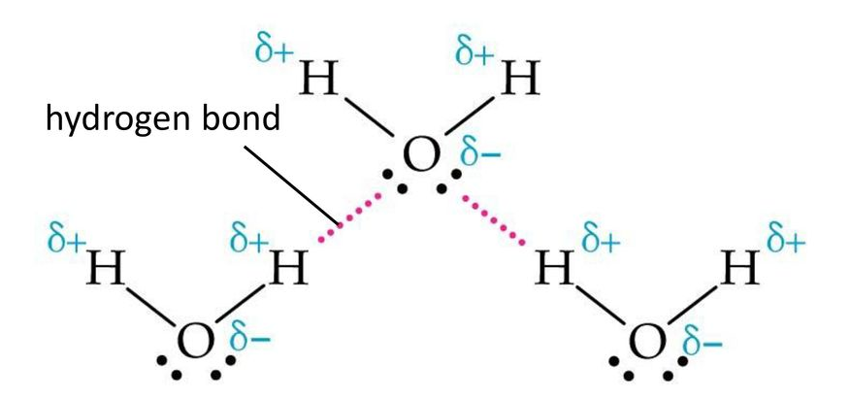
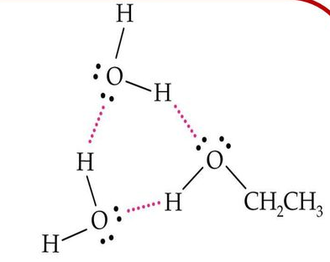

Slide 13
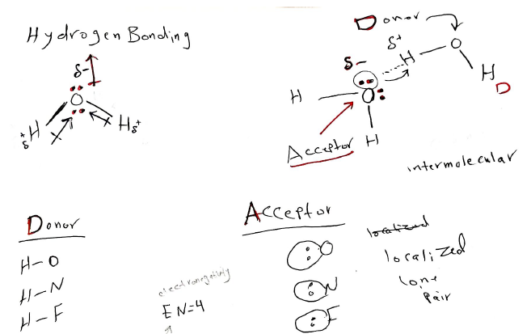

Slide 14
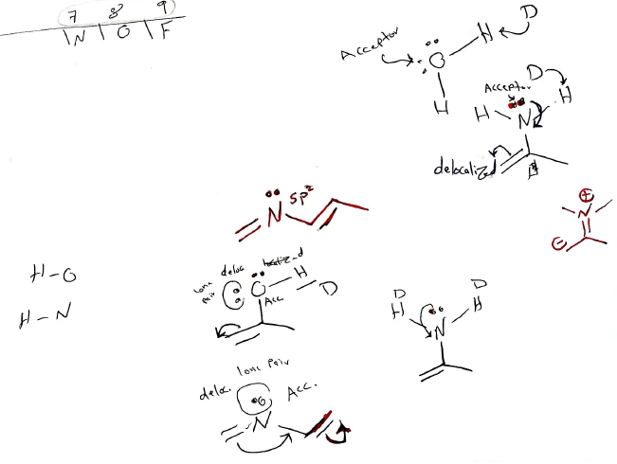

Slide 15
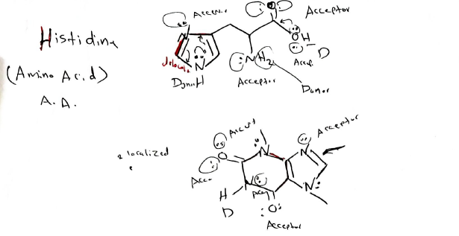

Slide 16
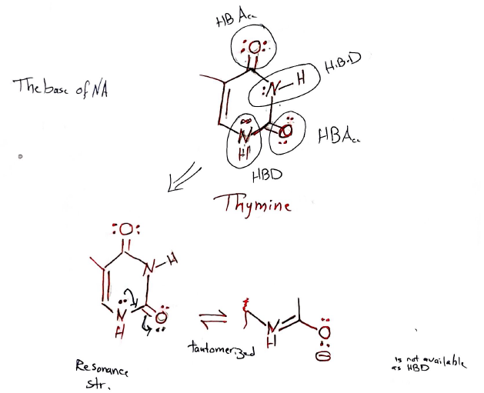

Slide 17
Recrystallization
- we want to purify this soild.

Slide 18
1. Choose a particular solvent.
- (at r.t, a low solubility; high temp. high solubility)
, given the , solubility Temp. entropic favorability of dissolution.

Slide 19
step 2
[Heat solvent & add to solid].
(so we will choose a solvent carefully, and we will it up to boiling or near the boiling).

Slide 20
- This will then be added to the impure solid, which has been placed in a beaker.
- we add more solvent, heating & stirring the contents of the beaker is necessary untile all of the solid is dissolved, being sure to add only as much as necessary for dissolution to occur.

Slide 21
Step 3
Begin cooling the solution.

Slide 22
Step 4
Crystals of pure solid will form.

Slide 23
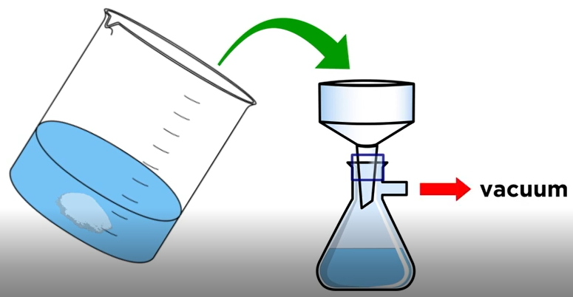
Step 5
Collect the crystals by filteration.
[once crystallization is completes we can use some filter paper on a Buchner funnel]

Slide 24

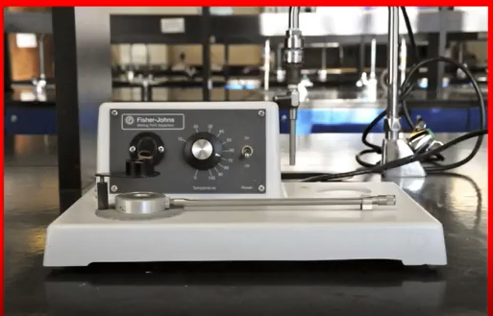
Step 6 test purity by M.P. Analysis.

Slide 25
Thin Layer chromatography (TLC) chromatography used as purification technique.
TLC separates mixtures of components and allows identification of the components.

Slide 26
